Slide 1
HOW WELLNESS COMPANY CAN PLAY IT SMART
DATA ANALYTICS CASE STUDY
By- Vishal Singh
Dataset- Bella beat by Fitbit Fitness Tracker Data
13th August 2021

Slide 2
OBJECTIVES
Suggesting solutions to Bella-beat company for growth.
Find key factors responsible for customer retention.
How could Bella-beat lure customers to buy its products
Comparative study of health of Bella-beat customers.

Slide 3
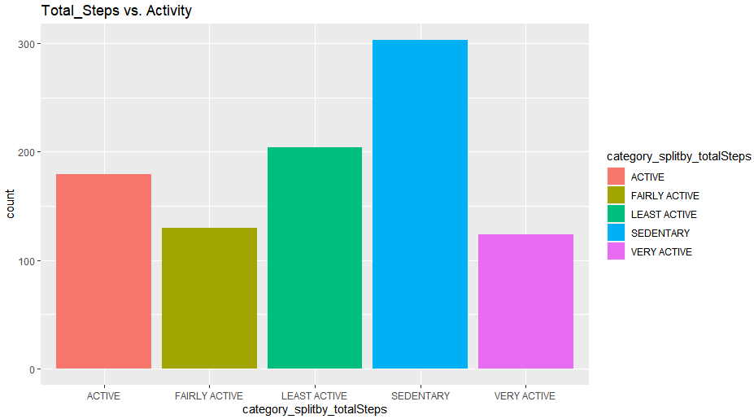
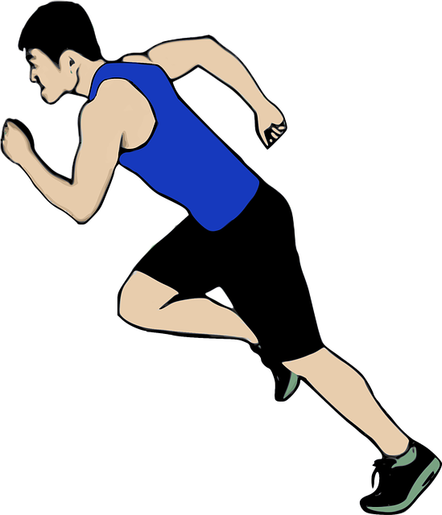
1. Total Steps Vs Activity Insight
This insight shows that the people belonging to the sedentary category are highest followed by least active people.

Slide 4
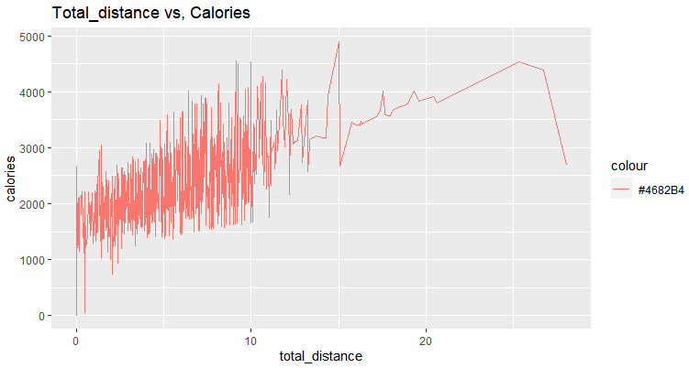
2. Total distance vs Calories Insight
As total distance increases calories burnt also increases, except for some abnormalities.
This may be because of using accelerometers in devices capturing movement of device also instead of just human movement.

Slide 5
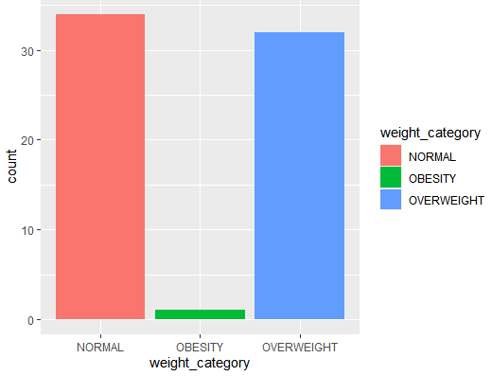
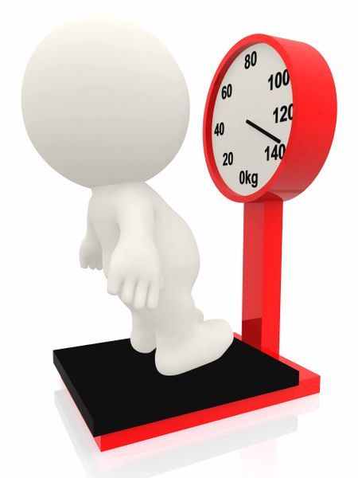
3. Weight Category of Customers
The density of population belonging to overweight category is considerably high though there are highest number of fit people.

Slide 6
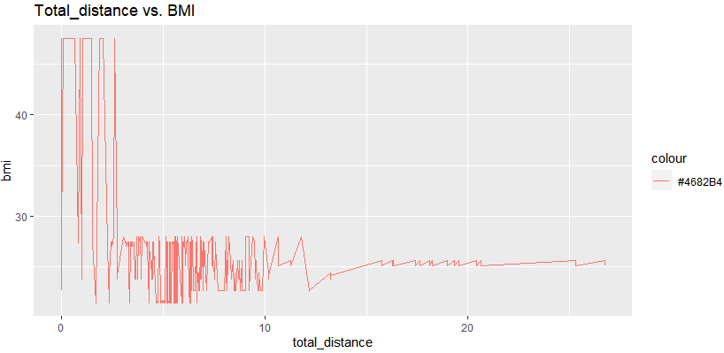
4. Total distance vs BMI
People maintaining healthy BMI often have travelled greater distance. Thus , Bella-beat can set up campaigns to enlighten people.

Slide 7
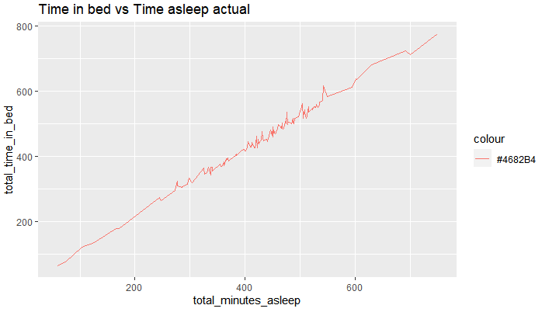

5. Time in Bed vs Actual Sleep
It is almost a linear relationship suggesting, people waste too much of time in bed apart from sleeping.
Bella- beat should suggest such people to rather work out to maintain healthy life .

Slide 8
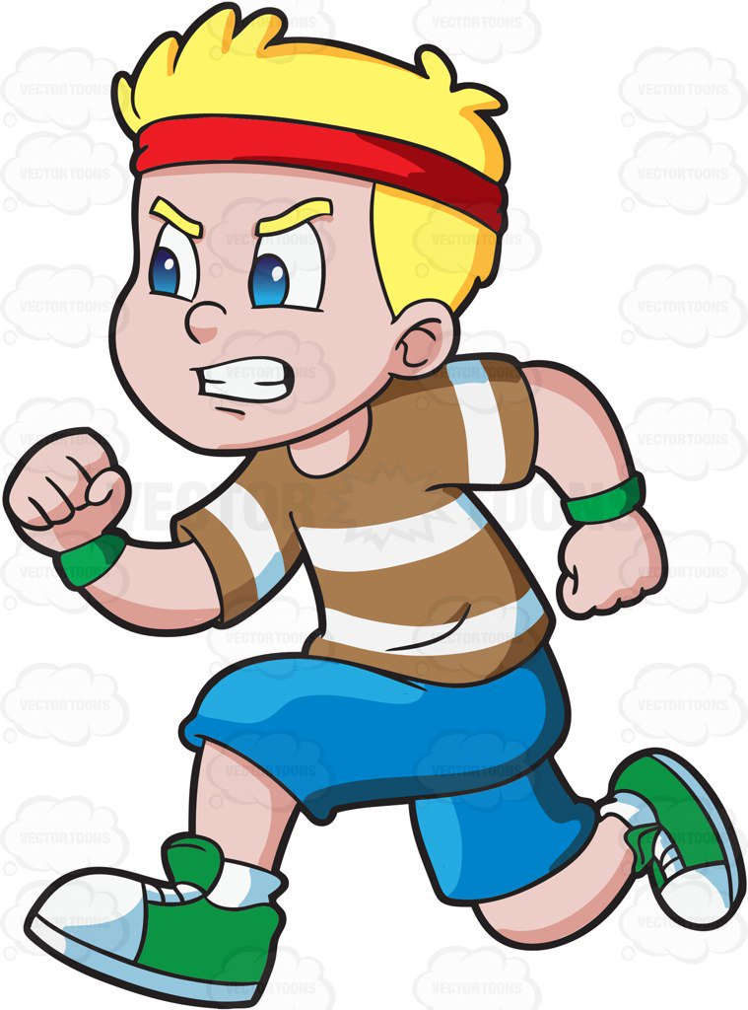
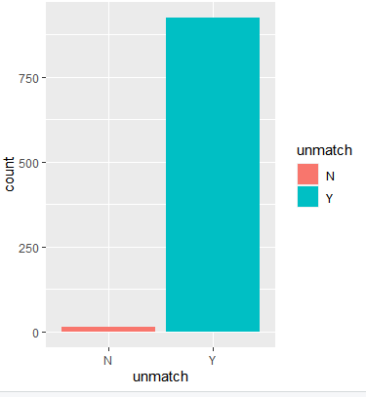
6. Total distance vs Tracker distance
“N” are those customer id’s whose total distance covered does not match with the distance covered shown by Bella- beat tracker device.
Though it is small in number when the sample taken is less, but it will grow as the sample space increases.

Slide 9
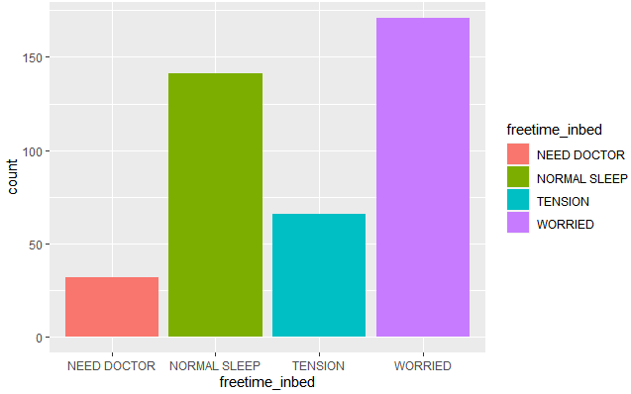
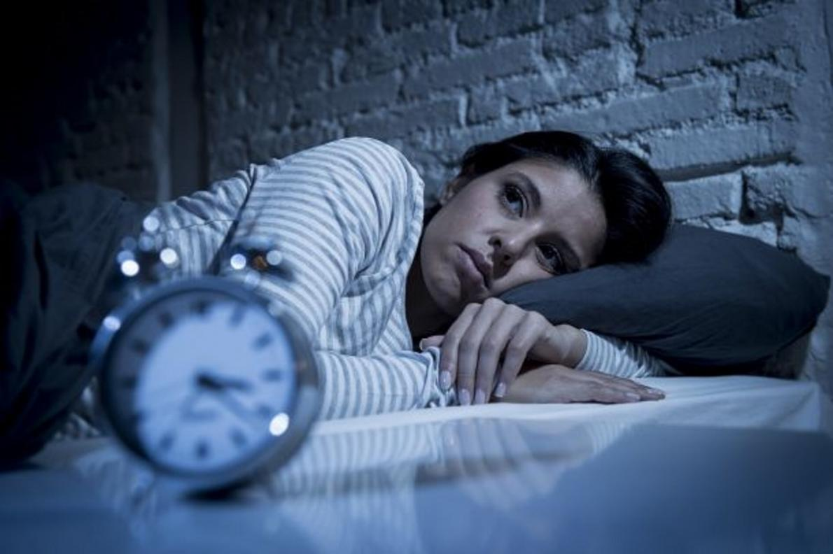
7. Sleep Disorders Signs
People having problems in going to sleep often remain awake for long hours in bed.
This graph shows the count of people needing medical assistance as they remain awake for very long time in bed.
This may be because of chronic insomnia.

Slide 10
KEY OBSERVATIONS
Too many people involved in sedentary activity.
The company may be using accelerometers to enhance tracker device activity.
People in “Overweight” category are very high.
People having good BMI are active and travel good distances.
People wasting too much time when in bed apart from sleeping.
The tracker device of Bella-beat is not digitally accurate.

Slide 11
MEASURES TO BE TAKEN
Bella-beat can advertise its customers to buy their tracker devices to maintain healthy records.
Bella-beat company should stop using accelerometers leading to unpopularity and false results among customers for its products.
Enlighten people about sleep disorders and advertising about its products to customers to keep track of such illness.
Enlighten its technical team about the devices not being digitally accurate to be corrected as soon as possible.

Slide 12


